Slide 1
INTRODUCTION TO COMPUTING
Course Code: CCINCOM/L
Temporal Difference
Elizer Ponio Jr.
Faculty Member
Department of Computer Science
College of Computing and Information Technologies (CCIT)
National University
Joseph Marvin R. Imperial
REINFORCEMENT LEARNING
NU College of Computing and Information Technologies
Course Code: CCRNFLRL

Slide 2
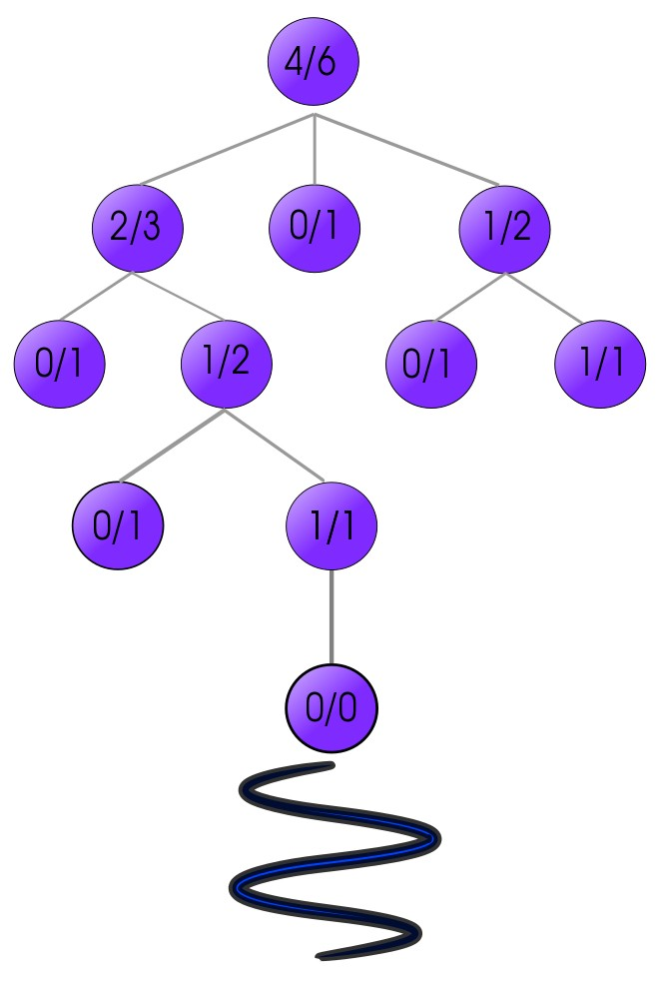
Can we improve Monte Carlo?
INTRODUCTION TO COMPUTING
Course Code: CCINCOM/L
The Monte-Carlo reinforcement learning algorithm overcomes the difficulty of strategy estimation caused by an unknown model. However, a disadvantage is that the strategy can only be updated after the whole episode.
Joseph Marvin R. Imperial
REINFORCEMENT LEARNING
NU College of Computing and Information Technologies
Course Code: CCRNFLRL

Slide 3
Temporal Difference (TD)
INTRODUCTION TO COMPUTING
Course Code: CCINCOM/L
Temporal Difference learning is a combination of Monte Carlo ideas and dynamic programming ideas.
Like Monte Carlo methods, TD methods can learn directly from raw experience without a model of the environment’s dynamics.
Like DP, TD methods update estimates based in part on other learned estimates, without waiting for a final outcome.
Both TD and Monte Carlo methods use experience to solve the prediction problem.
Joseph Marvin R. Imperial
REINFORCEMENT LEARNING
NU College of Computing and Information Technologies
Course Code: CCRNFLRL

Slide 4


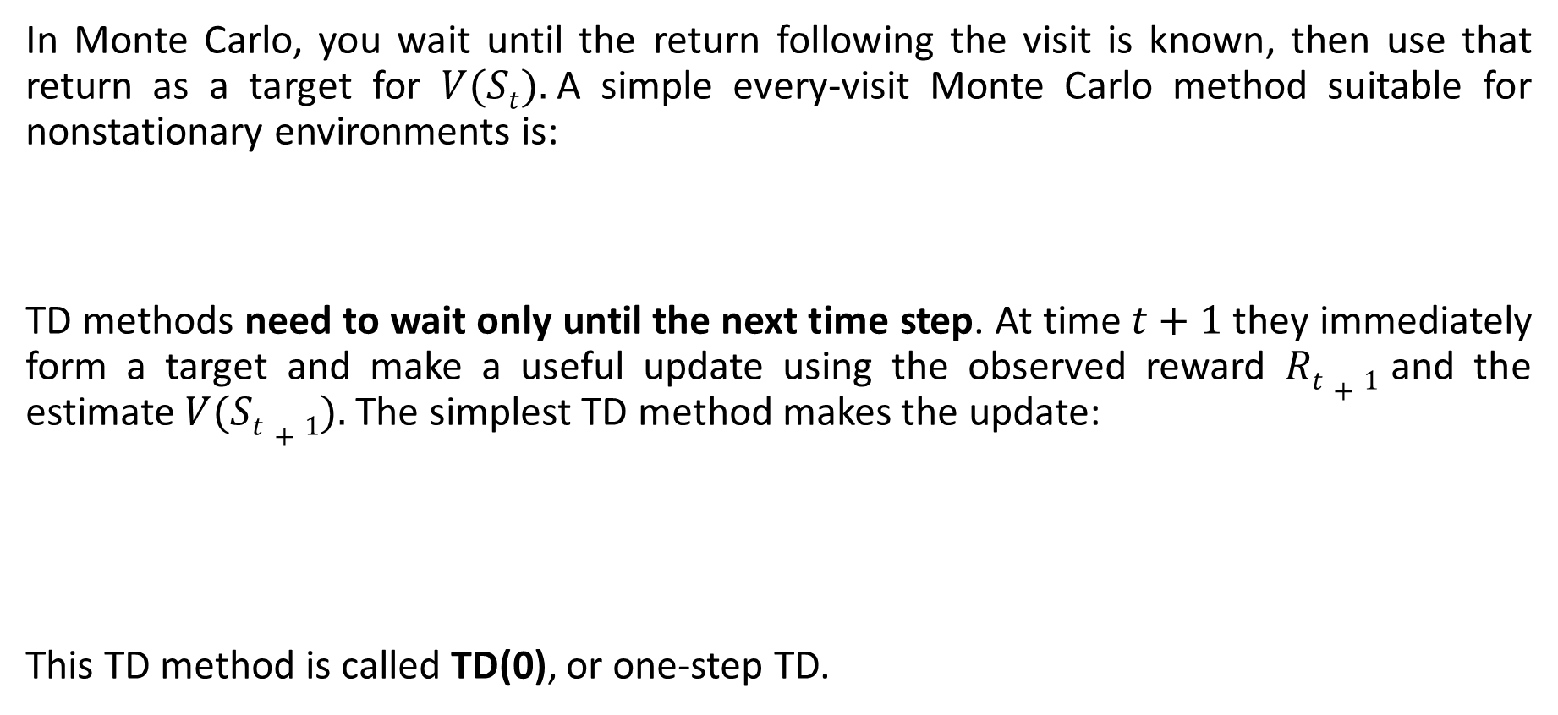
Main Difference
INTRODUCTION TO COMPUTING
Course Code: CCINCOM/L
In Monte Carlo, you wait until the return following the visit is known, then use that return as a target for $V(St).$A simple every-visit Monte Carlo method suitable for nonstationary environments is:
TD methods need to wait only until the next time step. At time $t+1$ they immediately form a target and make a useful update using the observed reward $Rt+1$ and the estimate $V(St+1).$The simplest TD method makes the update:
This TD method is called TD(0), or one-step TD.
Joseph Marvin R. Imperial
REINFORCEMENT LEARNING
NU College of Computing and Information Technologies
Course Code: CCRNFLRL

Slide 5
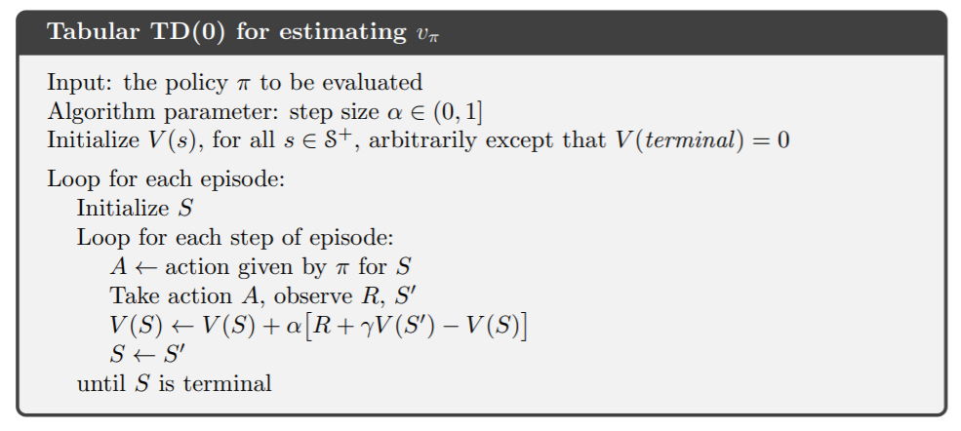
TD(0) Formalized
INTRODUCTION TO COMPUTING
Course Code: CCINCOM/L
Joseph Marvin R. Imperial
REINFORCEMENT LEARNING
NU College of Computing and Information Technologies
Course Code: CCRNFLRL

Slide 6
Advantages
INTRODUCTION TO COMPUTING
Course Code: CCINCOM/L
TD methods learn directly from episodes of experience. Sometimes called online or incremental learning.
TD is model-free. To knowledge of MDP transitions / rewards unlike DP methods.
TD learns from incomplete episodes, by bootstrapping.
TD updates a guess towards a guess.
TD methods update their estimates based in part on other estimates. They learn a guess from a guess—they bootstrap.
TD exploits Markov property.
In practice, TD methods have usually been found to converge faster than constant MC methods on tasks.
Joseph Marvin R. Imperial
REINFORCEMENT LEARNING
NU College of Computing and Information Technologies
Course Code: CCRNFLRL

Slide 7
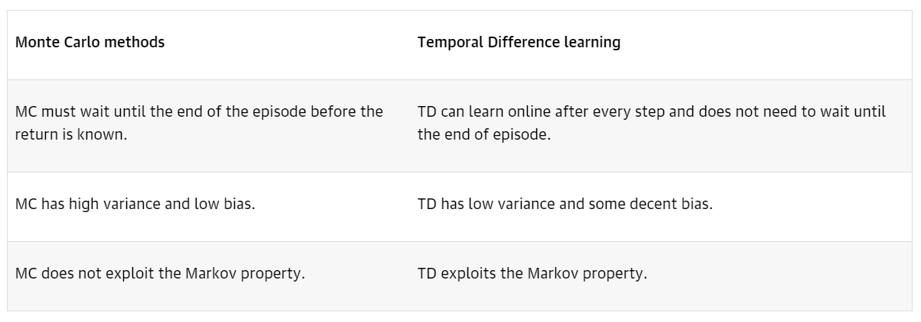
Tabulated Differences
INTRODUCTION TO COMPUTING
Course Code: CCINCOM/L
Joseph Marvin R. Imperial
REINFORCEMENT LEARNING
NU College of Computing and Information Technologies
Course Code: CCRNFLRL

Slide 8
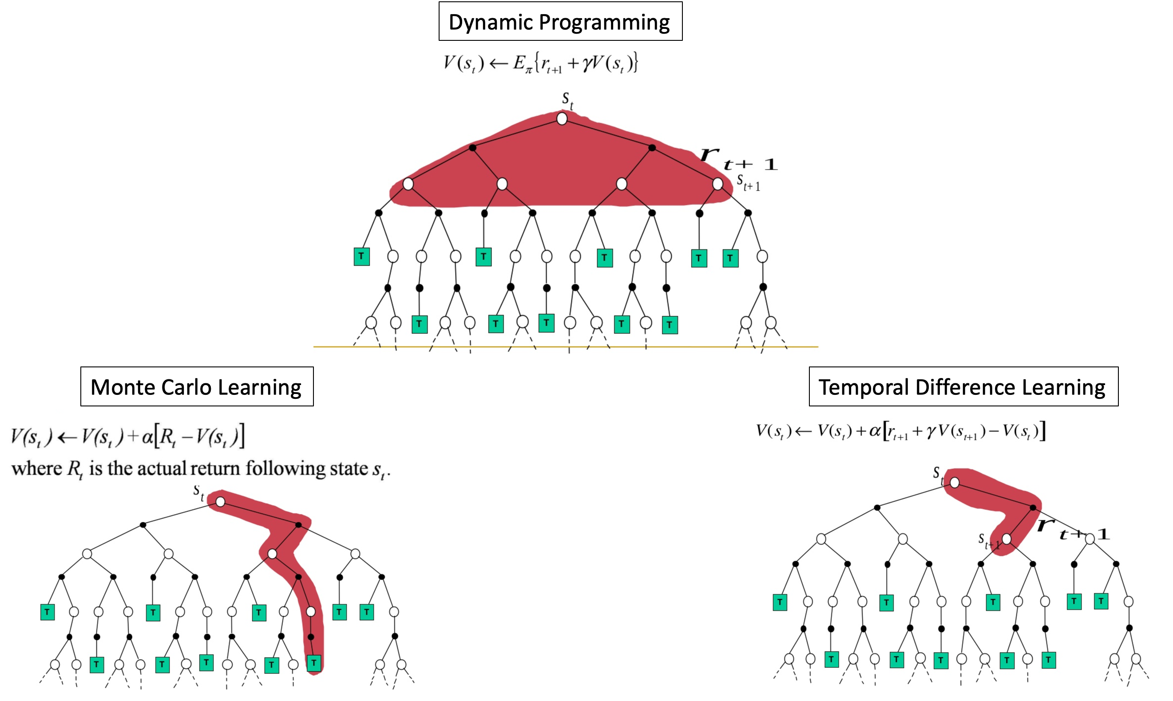
INTRODUCTION TO COMPUTING
Course Code: CCINCOM/L
Joseph Marvin R. Imperial
NU College of Computing and Information Technologies

Slide 9
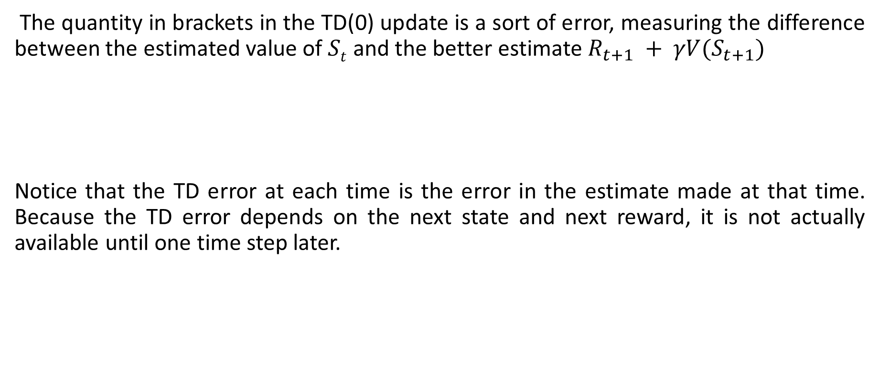
TD error γ
INTRODUCTION TO COMPUTING
Course Code: CCINCOM/L
The quantity in brackets in the TD(0) update is a sort of error, measuring the difference between the estimated value of $St$ and the better estimate $R_{t+1} + γV(S_{t+1})$
Notice that the TD error at each time is the error in the estimate made at that time. Because the TD error depends on the next state and next reward, it is not actually available until one time step later.
Joseph Marvin R. Imperial
REINFORCEMENT LEARNING
NU College of Computing and Information Technologies
Course Code: CCRNFLRL

Slide 10
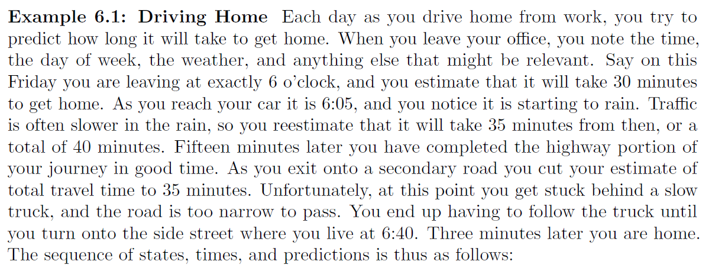
Driving Home
INTRODUCTION TO COMPUTING
Course Code: CCINCOM/L
Joseph Marvin R. Imperial
REINFORCEMENT LEARNING
NU College of Computing and Information Technologies
Course Code: CCRNFLRL

Slide 11
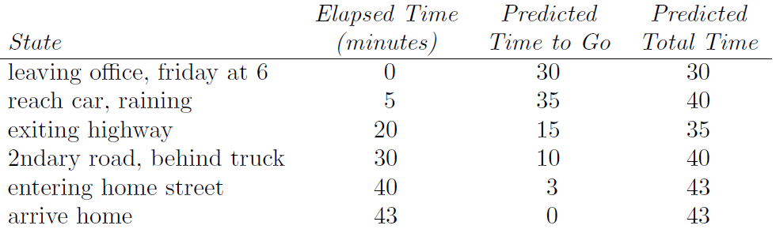
Driving Home
INTRODUCTION TO COMPUTING
Course Code: CCINCOM/L
Joseph Marvin R. Imperial
REINFORCEMENT LEARNING
NU College of Computing and Information Technologies
Course Code: CCRNFLRL

Slide 12
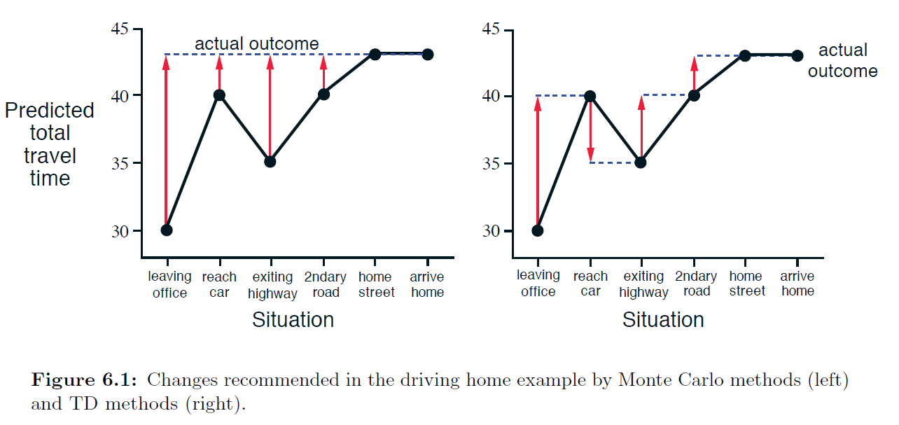
Driving Home
INTRODUCTION TO COMPUTING
Course Code: CCINCOM/L
Joseph Marvin R. Imperial
REINFORCEMENT LEARNING
NU College of Computing and Information Technologies
Course Code: CCRNFLRL

Slide 13
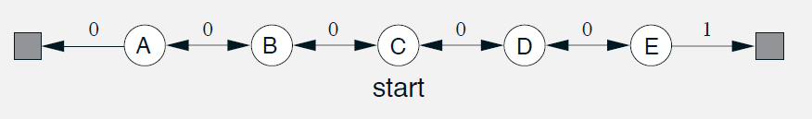
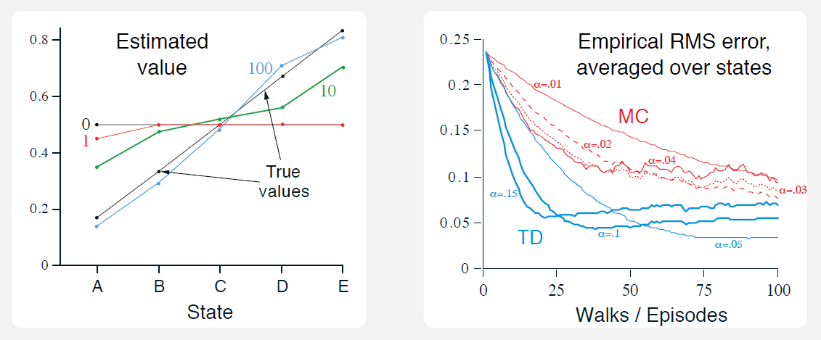
Random Walk (TD vs. MC)
INTRODUCTION TO COMPUTING
Course Code: CCINCOM/L
Joseph Marvin R. Imperial
REINFORCEMENT LEARNING
NU College of Computing and Information Technologies
Course Code: CCRNFLRL

Slide 14
Types of Policies
INTRODUCTION TO COMPUTING
Course Code: CCINCOM/L
Behavior Policy – it is the policy that an agent is trying to learn i.e. agent is learning value function for this policy.
Target Policy – it is the policy that is being used by an agent for action select i.e. agent follows this policy to interact with the environment.
Joseph Marvin R. Imperial
REINFORCEMENT LEARNING
NU College of Computing and Information Technologies
Course Code: CCRNFLRL

Slide 15
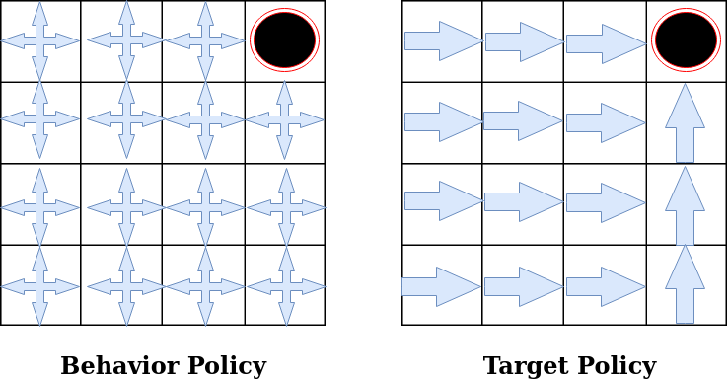
Types of Policies
INTRODUCTION TO COMPUTING
Course Code: CCINCOM/L
Joseph Marvin R. Imperial
REINFORCEMENT LEARNING
NU College of Computing and Information Technologies
Course Code: CCRNFLRL

Slide 16
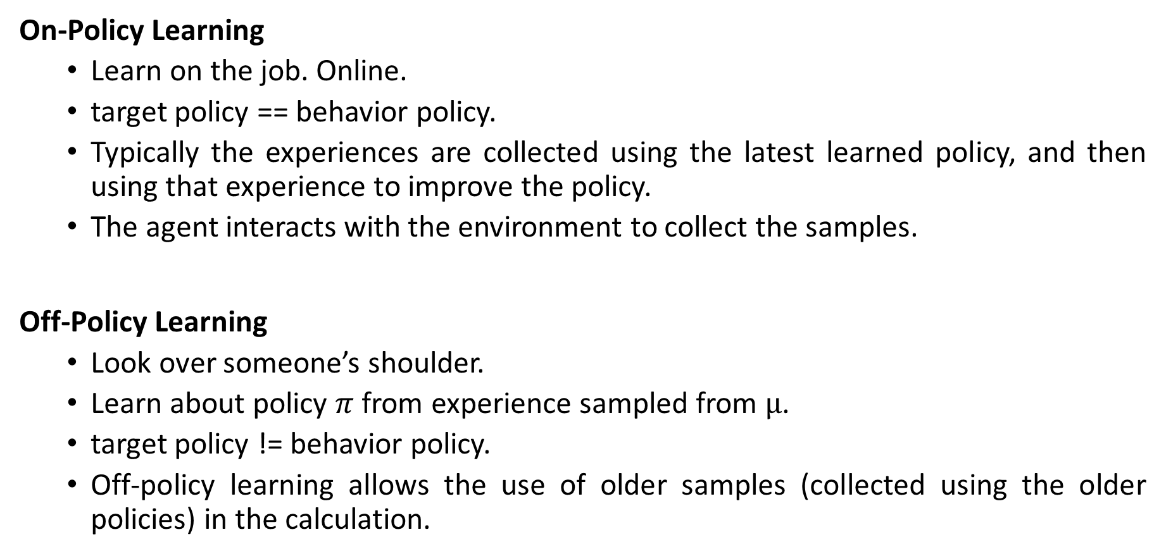
Off vs. On Policy Learning
INTRODUCTION TO COMPUTING
Course Code: CCINCOM/L
On-Policy Learning
Learn on the job. Online.
target policy == behavior policy.
Typically the experiences are collected using the latest learned policy, and then using that experience to improve the policy.
The agent interacts with the environment to collect the samples.
Off-Policy Learning
Look over someone’s shoulder.
Learn about policy $π$ from experience sampled from $µ$.
target policy != behavior policy.
Off-policy learning allows the use of older samples (collected using the older policies) in the calculation.
Joseph Marvin R. Imperial
REINFORCEMENT LEARNING
NU College of Computing and Information Technologies
Course Code: CCRNFLRL

Slide 17
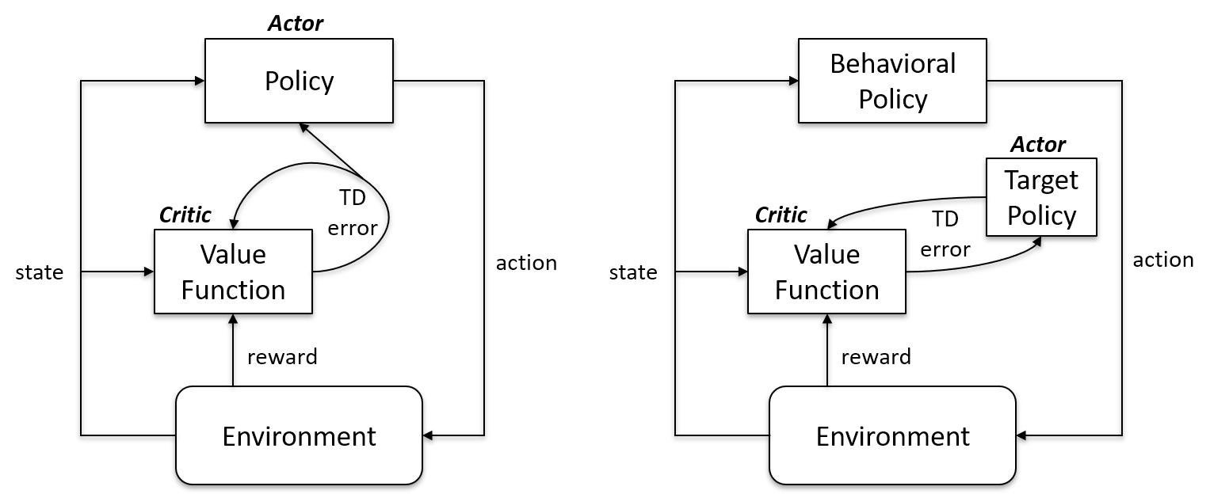
Off vs. On Policy Learning
INTRODUCTION TO COMPUTING
Course Code: CCINCOM/L
Joseph Marvin R. Imperial
REINFORCEMENT LEARNING
NU College of Computing and Information Technologies
Course Code: CCRNFLRL

Slide 18
INTRODUCTION TO COMPUTING
Course Code: CCINCOM/L
Q Learning
Joseph Marvin R. Imperial
Faculty Member
Department of Computer Science
College of Computing and Information Technologies (CCIT)
National University
Joseph Marvin R. Imperial
REINFORCEMENT LEARNING
NU College of Computing and Information Technologies
Course Code: CCRNFLRL

Slide 19
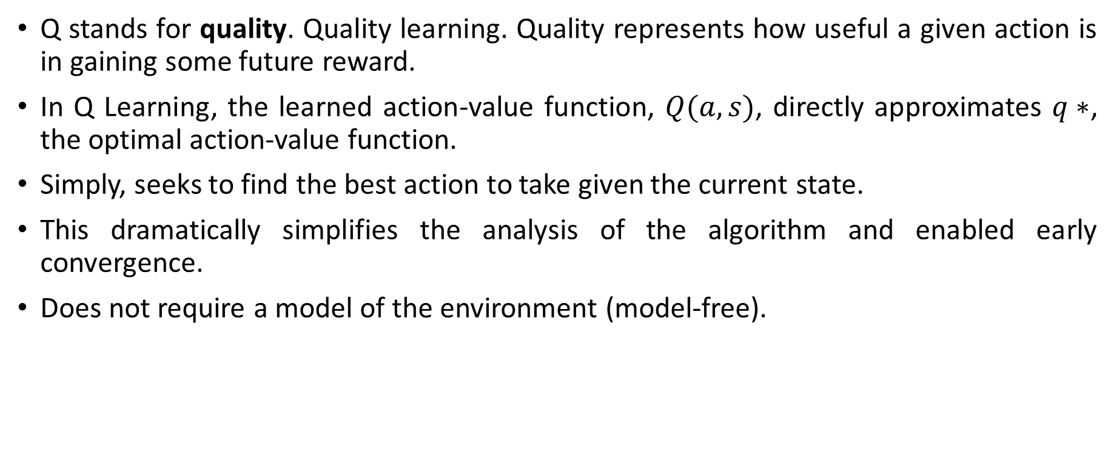
Q-Learning
INTRODUCTION TO COMPUTING
Course Code: CCINCOM/L
Q stands for quality. Quality learning. Quality represents how useful a given action is in gaining some future reward.
In Q Learning, the learned action-value function, $Q(a,s)$, directly approximates $q∗$, the optimal action-value function.
Simply, seeks to find the best action to take given the current state.
This dramatically simplifies the analysis of the algorithm and enabled early convergence.
Does not require a model of the environment (model-free).
Joseph Marvin R. Imperial
REINFORCEMENT LEARNING
NU College of Computing and Information Technologies
Course Code: CCRNFLRL

Slide 20
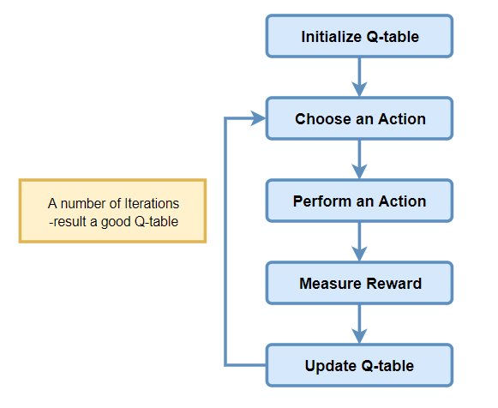
Q-Learning Flowchart
INTRODUCTION TO COMPUTING
Course Code: CCINCOM/L
Joseph Marvin R. Imperial
REINFORCEMENT LEARNING
NU College of Computing and Information Technologies
Course Code: CCRNFLRL

Slide 21
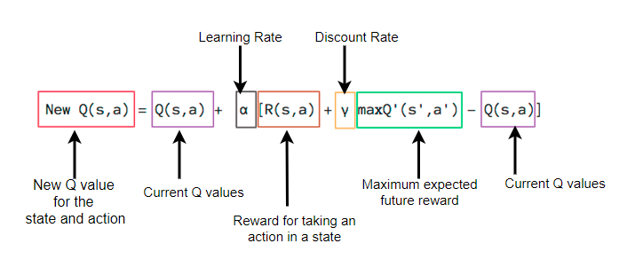
Q-Learning
INTRODUCTION TO COMPUTING
Course Code: CCINCOM/L
Joseph Marvin R. Imperial
REINFORCEMENT LEARNING
NU College of Computing and Information Technologies
Course Code: CCRNFLRL

Slide 22
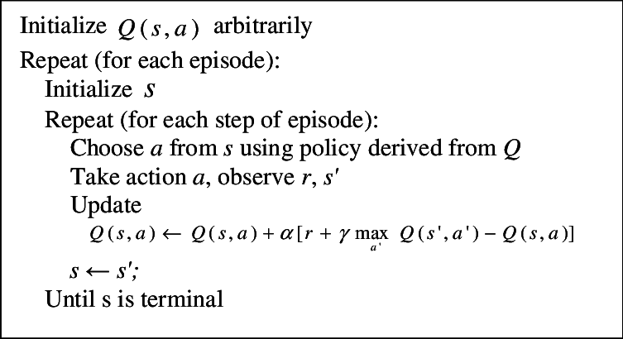
Q-Learning Algorithm
INTRODUCTION TO COMPUTING
Course Code: CCINCOM/L
Joseph Marvin R. Imperial
REINFORCEMENT LEARNING
NU College of Computing and Information Technologies
Course Code: CCRNFLRL

Slide 23
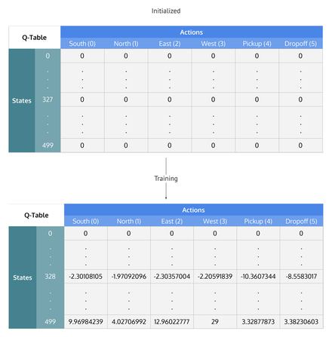
Q-Learning Training
INTRODUCTION TO COMPUTING
Course Code: CCINCOM/L
Q-Learning table of states by actions that is initialized to zero, then each cell is updated through training.
Joseph Marvin R. Imperial
REINFORCEMENT LEARNING
NU College of Computing and Information Technologies
Course Code: CCRNFLRL

Slide 24
Q-Learning Training
INTRODUCTION TO COMPUTING
Course Code: CCINCOM/L
Joseph Marvin R. Imperial
REINFORCEMENT LEARNING
NU College of Computing and Information Technologies
Course Code: CCRNFLRL

Slide 25
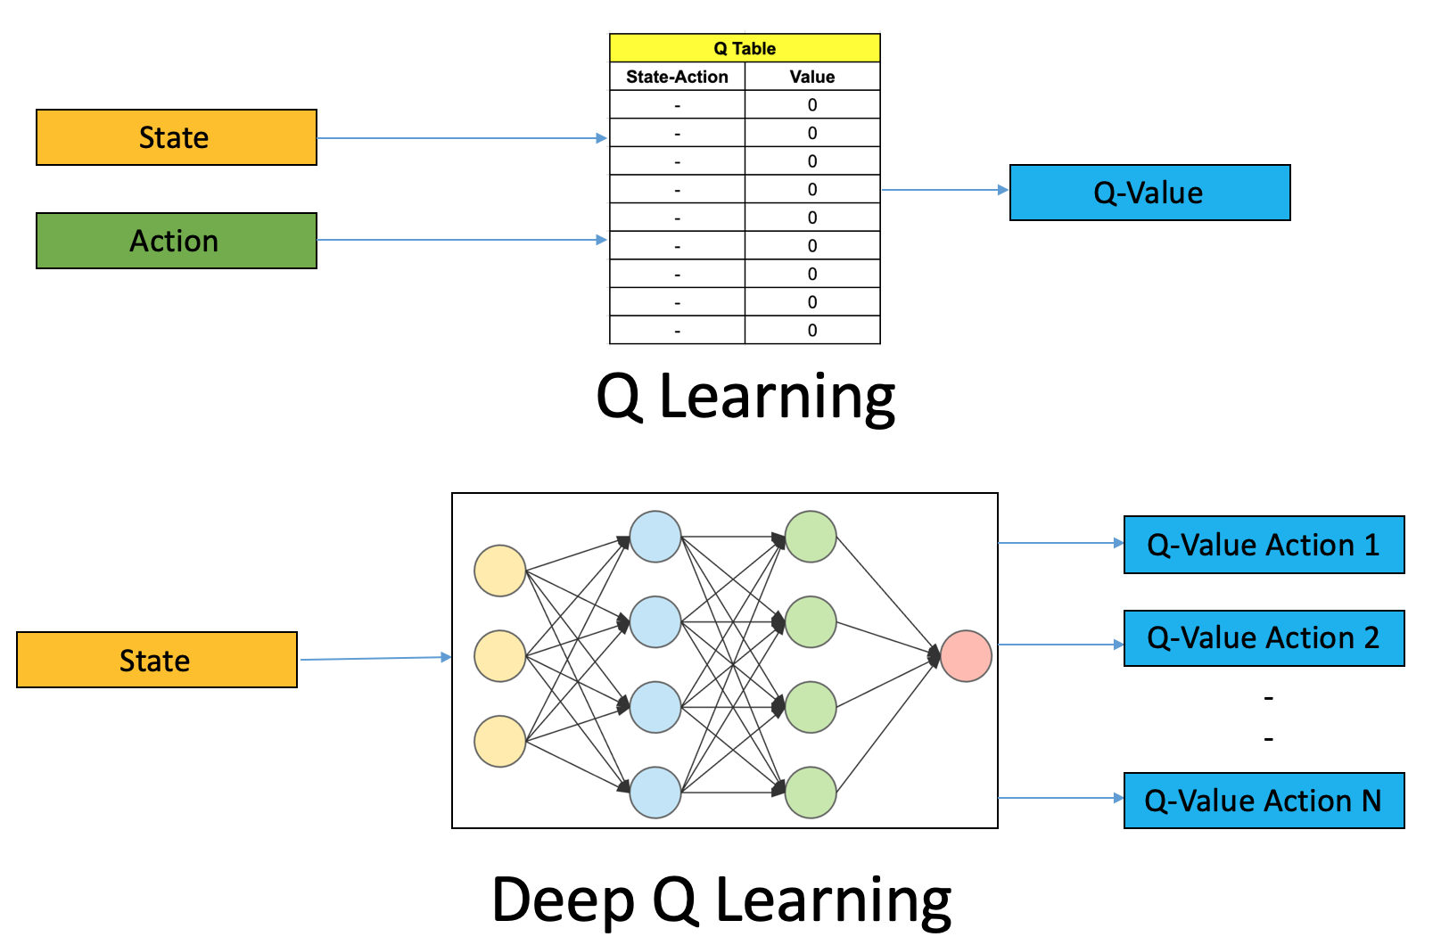
Q-Learning
INTRODUCTION TO COMPUTING
Course Code: CCINCOM/L
Joseph Marvin R. Imperial
REINFORCEMENT LEARNING
NU College of Computing and Information Technologies
Course Code: CCRNFLRL

Slide 26
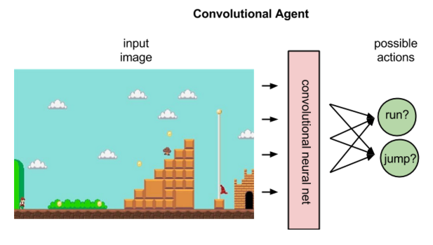
Q-Learning (Super Mario)
INTRODUCTION TO COMPUTING
Course Code: CCINCOM/L
Joseph Marvin R. Imperial
REINFORCEMENT LEARNING
NU College of Computing and Information Technologies
Course Code: CCRNFLRL

Slide 27
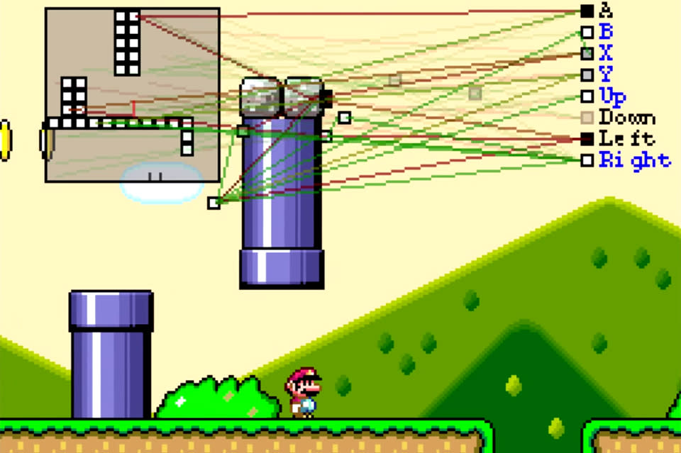
Q-Learning (Super Mario)
INTRODUCTION TO COMPUTING
Course Code: CCINCOM/L
Joseph Marvin R. Imperial
REINFORCEMENT LEARNING
NU College of Computing and Information Technologies
Course Code: CCRNFLRL

Slide 28
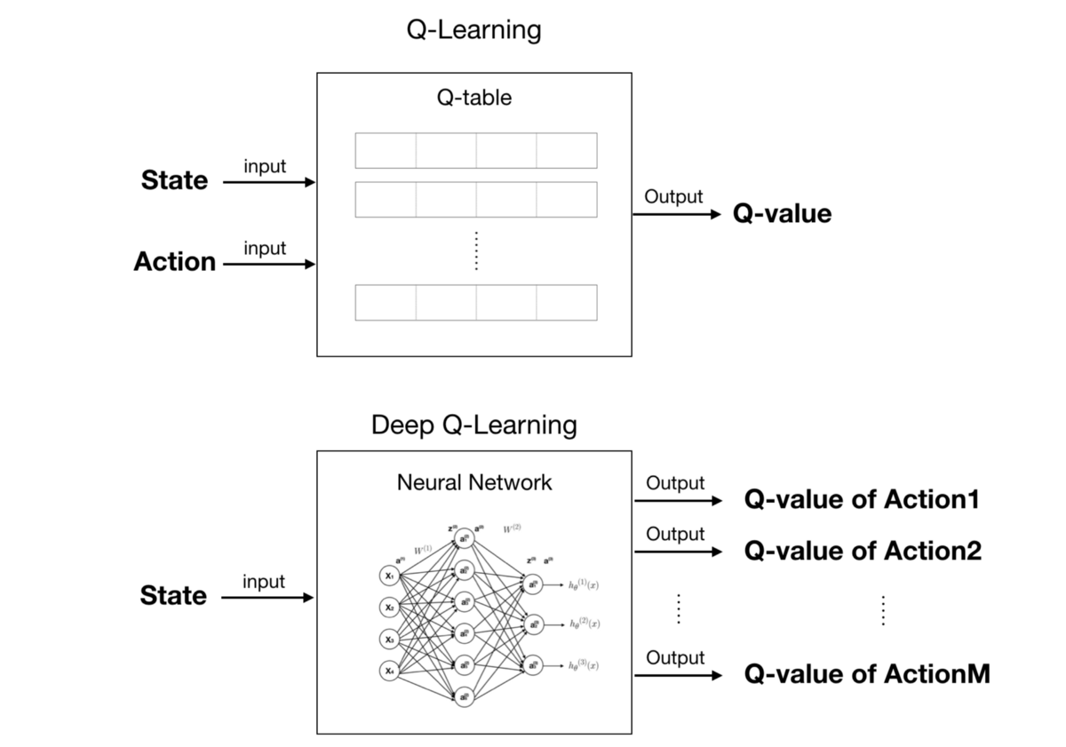
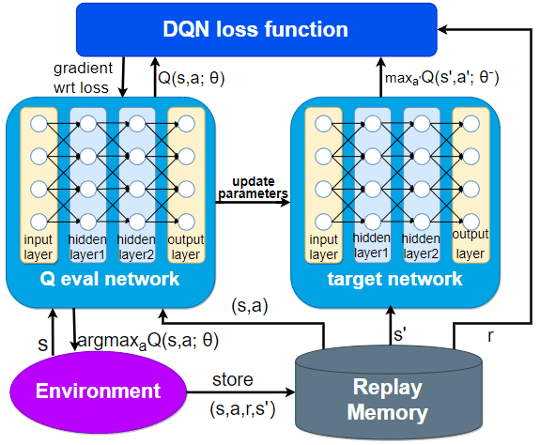
Deep Q Network
INTRODUCTION TO COMPUTING
Course Code: CCINCOM/L
Joseph Marvin R. Imperial
REINFORCEMENT LEARNING
NU College of Computing and Information Technologies
Course Code: CCRNFLRL

Slide 29
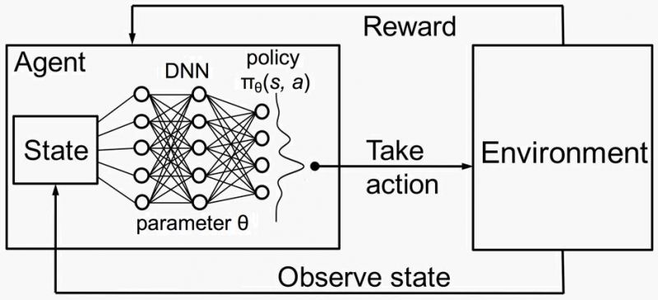
Deep Q Network
INTRODUCTION TO COMPUTING
Course Code: CCINCOM/L
Joseph Marvin R. Imperial
REINFORCEMENT LEARNING
NU College of Computing and Information Technologies
Course Code: CCRNFLRL

Slide 30
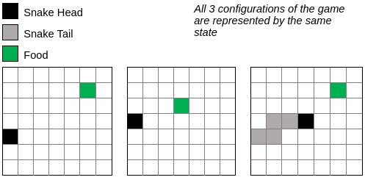
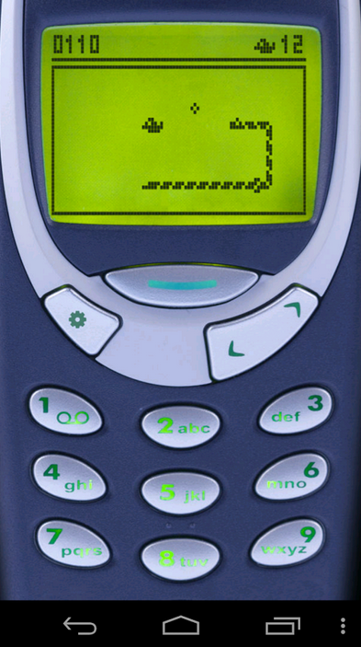
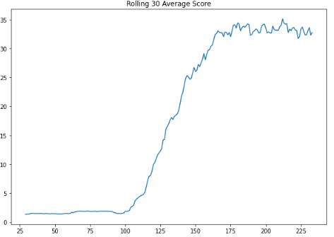
Q-Learning Demo
INTRODUCTION TO COMPUTING
Course Code: CCINCOM/L
Snake Game using Q-Learning
Joseph Marvin R. Imperial
REINFORCEMENT LEARNING
NU College of Computing and Information Technologies
Course Code: CCRNFLRL

Slide 31
References
INTRODUCTION TO COMPUTING
Course Code: CCINCOM/L
Images are licensed with Creative Commons. Can use without citing.
Prof. Emma Brunskill’s slides (CS234RL). https://web.stanford.edu/class/cs234/slides/lecture1.pdf
David Silver’s slides. https://www.davidsilver.uk/wp-content/uploads/2020/03/intro_RL.pdf
Review in Probability, Intro to RL Concepts
Joseph Marvin R. Imperial
REINFORCEMENT LEARNING
NU College of Computing and Information Technologies
Course Code: CCRNFLRL

